Slide 1
Delimiter Matching
By Anthony Randall and Ryan Nieves

Slide 2
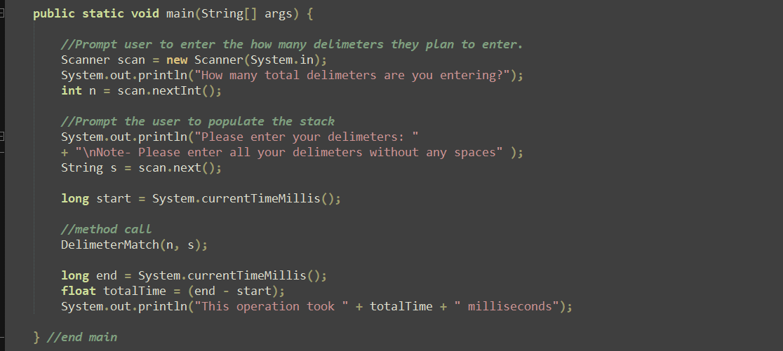
Step One:
Our first step is to prompt user to enter the amount of delimiters they plan to enter and the actual delimiters they want to use.

Slide 3
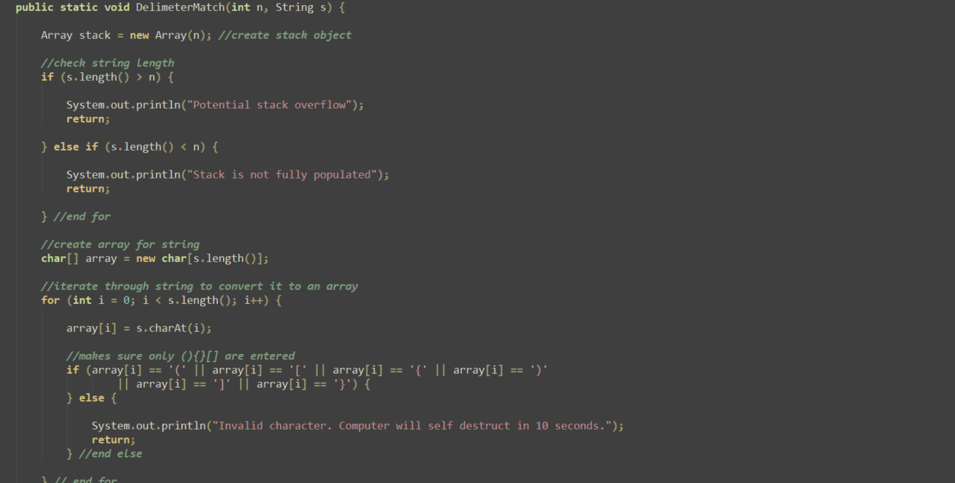
Step two:
In step two we call the DelimiterMatch method which creates an instance of the Array class then converts the user created String to an array. Finally it checks for overflows, underflows, and invalid characters prior to continuing on.

Slide 4
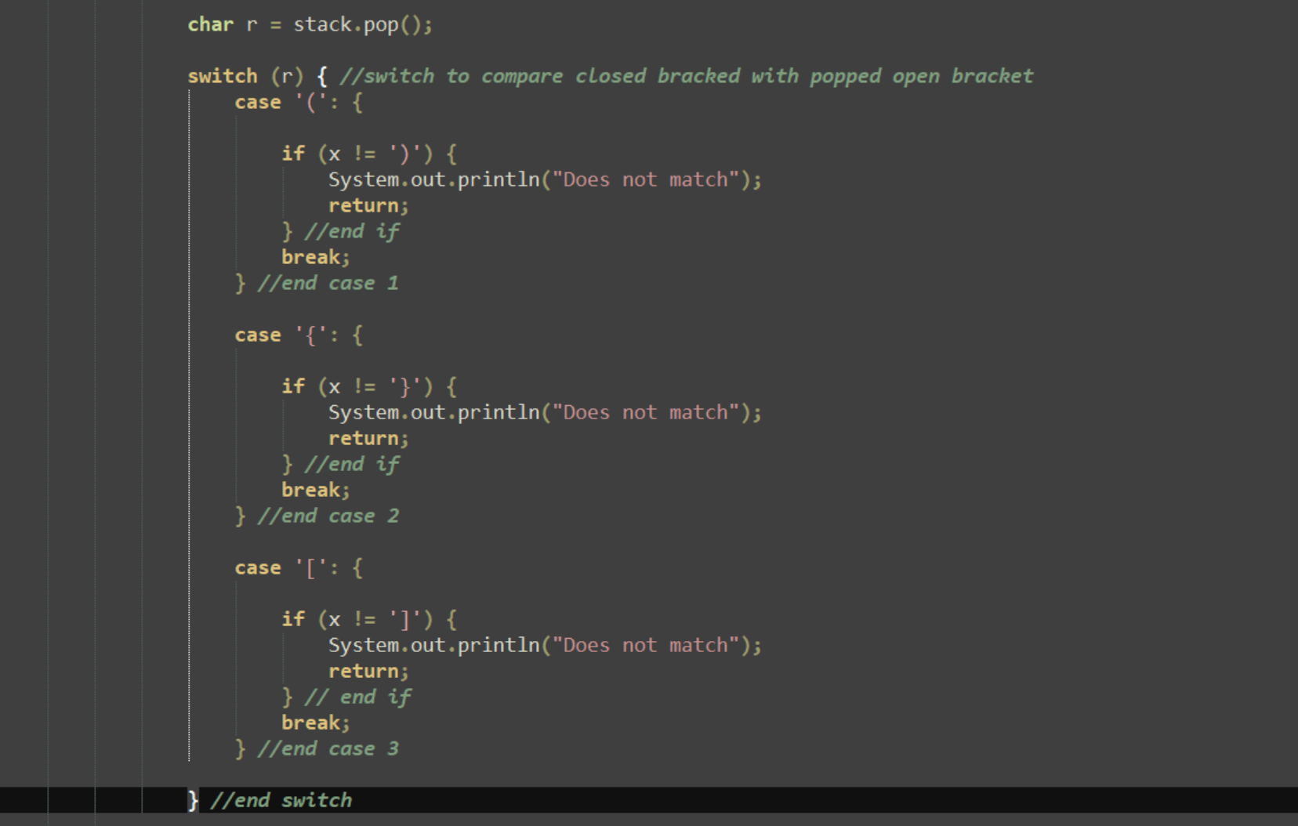
Step three:
The method then iterates through the user populated array with a foreach loop and pushes any open delimiters into the stack and pops any open delimiters out of the stack when it comes across a closed delimiter. It then compares the two to make sure they are the same type of delimiter and that an open has a matching closed.

Slide 5
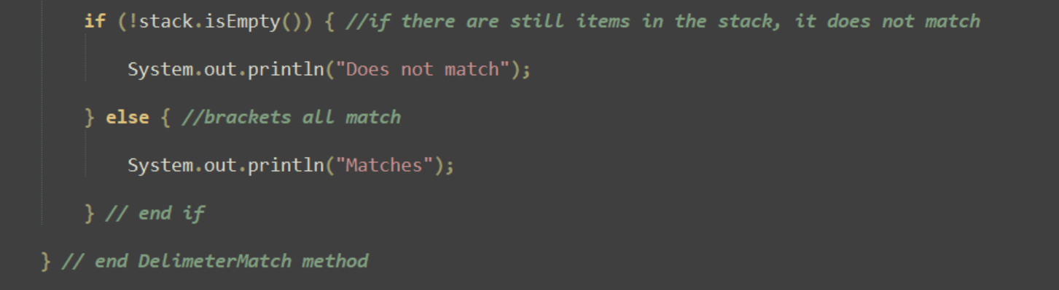
Step four:
Finally, if the stack is empty and the method has gotten through the switch, then the delimiter set matches.

Slide 6
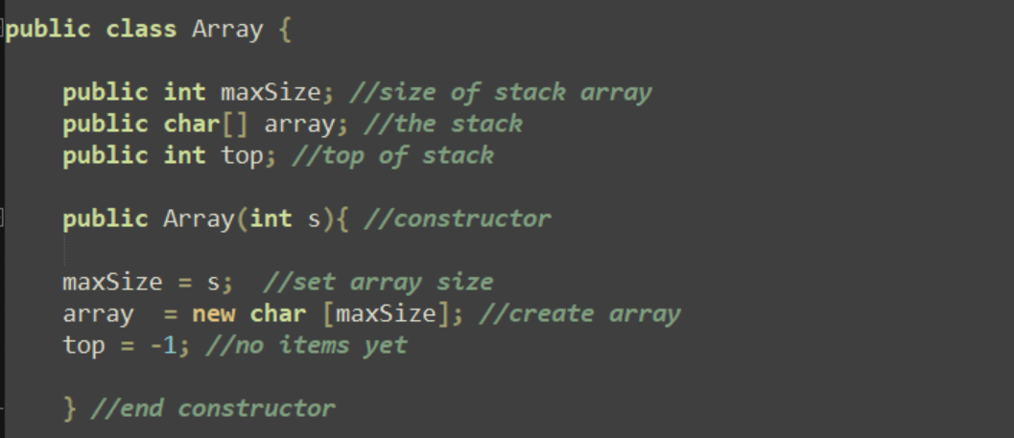
Array class
Variables used in array class and its constructor.

Slide 7
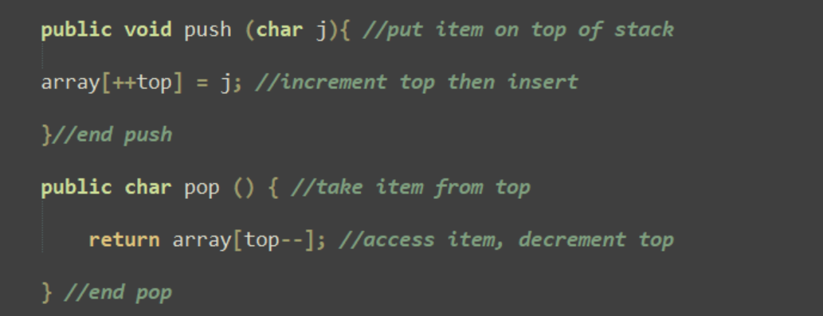
Array class (cont.)
Pop and push methods used.

Slide 8
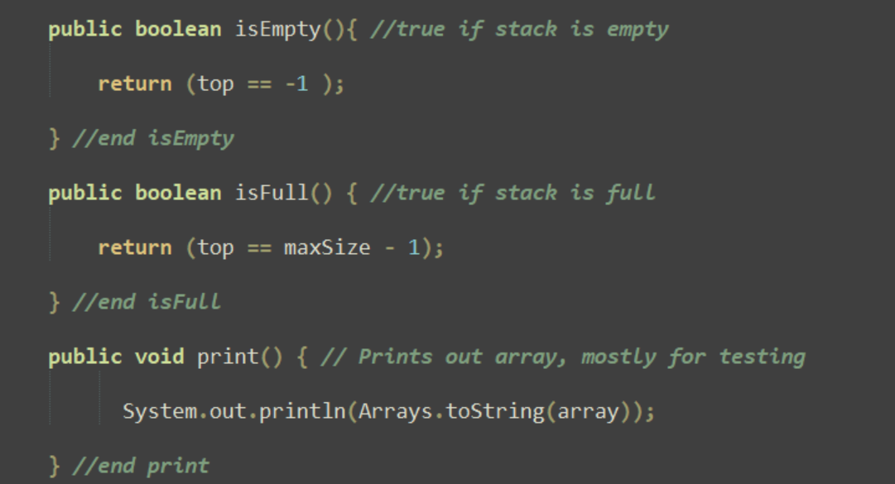
Array class (cont.)
Finally, the two boolean methods used to determine if the stack is full or empty. Used to detect underflow or overflow errors.

